Slide 1
Chapter 6: Session Hijacking
Spoofing vs. Hijacking
Types of Session Hijacking
Sequence prediction
Steps in performing session hijacking

Slide 2
What is Session Hijacking?
Exploitation of a valid computer session where an attacker takes over a session between two computers.
Session Hijacking is when an attacker gets access to the session state of a particular user.
The attacker steals a valid session ID which is used to get into system and retrieve the data.

Slide 3
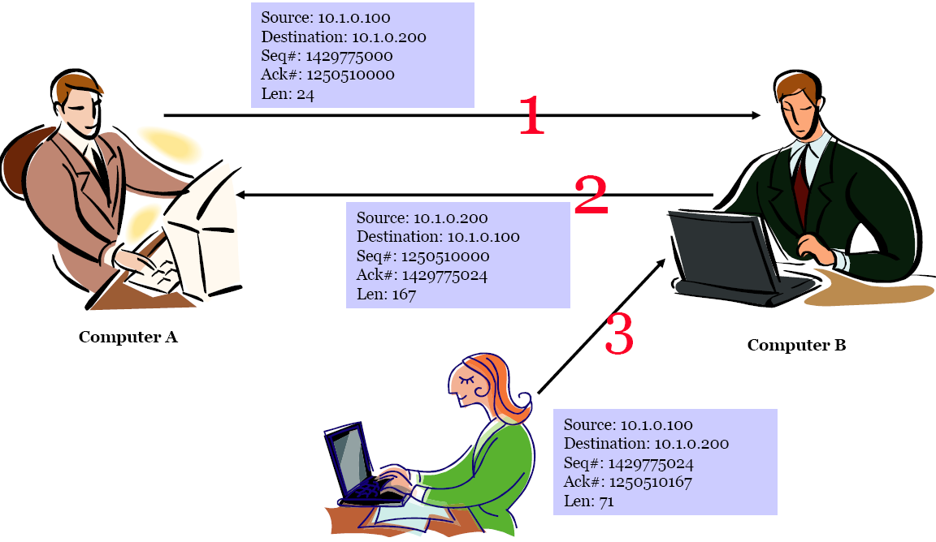
TCP Hijacking
TCP session hijacking is when an attacker takes over a TCP session between two machines
Most authentication only occurs at the start of a TCP session, this allows the attacker to gain access to a machine.

Slide 4
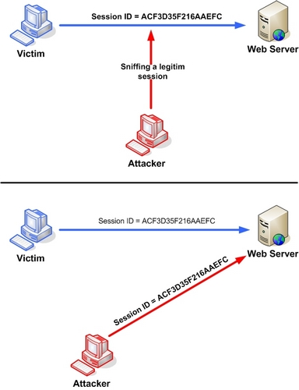
TCP Hijacking
The attacker steals a valid session ID which is used to get into the system and retrieve the data

Slide 5
Spoofing vs. Hijacking
Hijacking | Spoofing
The process of taking over an existing active session. In session hijacking attacker pretends to be another user or machine (victim) to gain access. Hijacking is done only after the victim is connected to the server An attacker takes over an existing session, which means he/she relies on the legitimate user to make a connection and authenticate Subsequently, the attacker takes over the session | An attacker does not actively take another user offline to perform the attack. He mainly pretends to be another user or machine to gain access. Its done through Cain & Abel

Slide 6
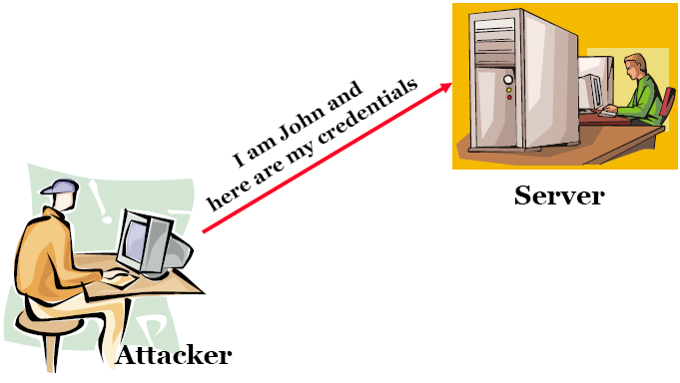

Spoofing

Slide 7
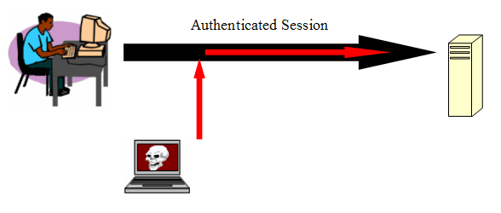
Hijacking

Slide 8
General Steps in Session Hijacking
Place yourself between the victim and the target (you must be able to sniff the network)
Monitor the flow of packets
Predict the sequence number
Break/Kill the connection to the victim’s machine
Take over the session
Start injecting packets to the target server

Slide 9
3-way handshake

Slide 10
Types Of Session Hijacking
Active
In an active attack, an attacker finds an active session and takes over
Passive
With passive attack, an attacker hijacks a session, but sits back, and watches and records all the traffic that is being sent forth

Slide 11
Session Hijacking Levels
Network Level Hijacking
Can be defined as the interception of the packets during the transmission between the client and the server in a TCP and UDP session
Network level hijacking includes:
TCP/IP Hijacking
IP Spoofing: Source Routed Packets
RST Hijacking
Blind Hijacking
Man in the Middle: Packet Sniffer
UDP Hijacking

Slide 12
Session Hijacking Levels
Application Level Hijacking
Application level is about gaining control on HTTP’s user session by obtaining the session ID’s
Application Level Hijacking includes:
Obtaining session ID’s
Sniffing
Brute Force
Misdirected Trust

Slide 13
Countermeasures/Mitigation: Protecting against Session Hijacking
Use encryption
Use a secure HTTPS protocol (full SSL)
Limit incoming connections
Minimize remote access
Use a VPN when connecting remotely
Click “Log out” (doesn't guarantee session is invalidated)
Use at least WPAII for your WiFi
Protect access to your own networks
Limit exposure to untrusted networks
Educate the employees

Slide 14
Tools
Some examples:
TTY Watcher
IP Watcher
Remote TCP Session Reset Utility
Paros HTTP Hijacker
Dnshijacker
Hjksuite
Juggernaut
Hunt
T-Sight
DroidSheep for Android
Firesheep (Firefox addon)

Slide 15
Summary
In the case of a session hijacking, an attacker relies on the legitimate user to connect and authenticate, and will then take over the session
In a spoofing attack, the attacker pretends to be another user or machine to gain access
Successful session hijacking is difficult and is only possible when a number of factors are under the attacker's control
Session hijacking can be active or passive in nature depending on the degree of involvement of the attacker
A variety of tools exist to aid the attacker in perpetrating a session hijack
Session hijacking could be dangerous, and therefore, there is a need for implementing strict countermeasures

